Slide 1
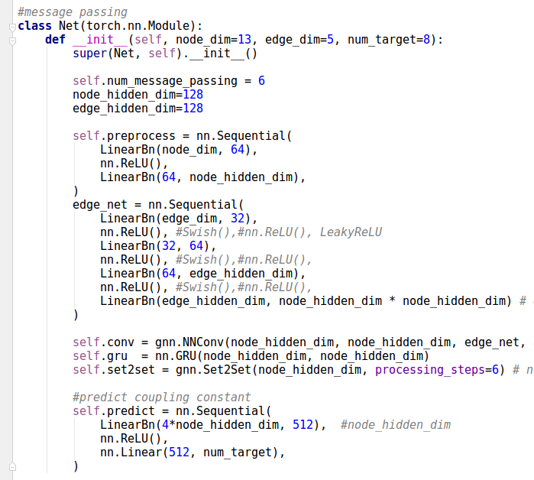
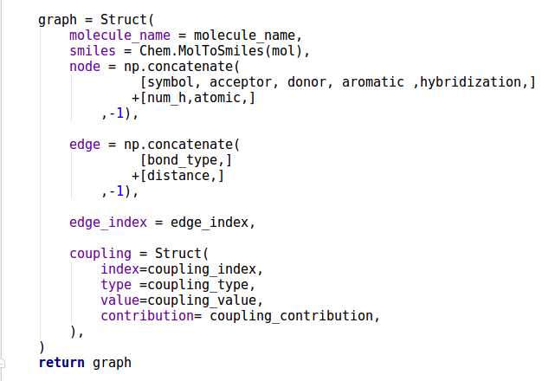
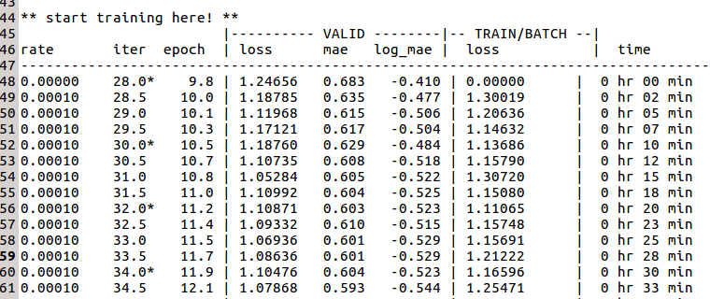
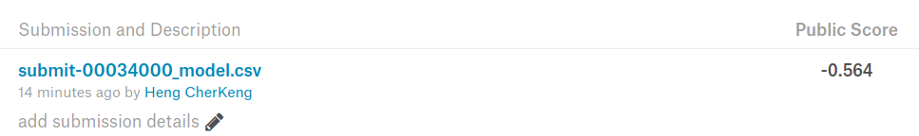
Message Passing Network Starter Kit
reference paper:
”Neural Message Passing forQuantum Chemistry” - ICML 2017
https://ai.googleblog.com/2017/04/predicting-properties-of-molecules-with.html
1. graph.py : creation of graph and
atom/bond feature extraction
2. model.py : example of MPNN
3. example of submission results
(no tunning of model yet)

